Slide 1



Movement-related β-modulation and visuomotor learning
Federico Carrara
Iacopo Zinno
In collaboration with:
Lice Ghilardi, MD
Elisa Tatti, PHD

Slide 2
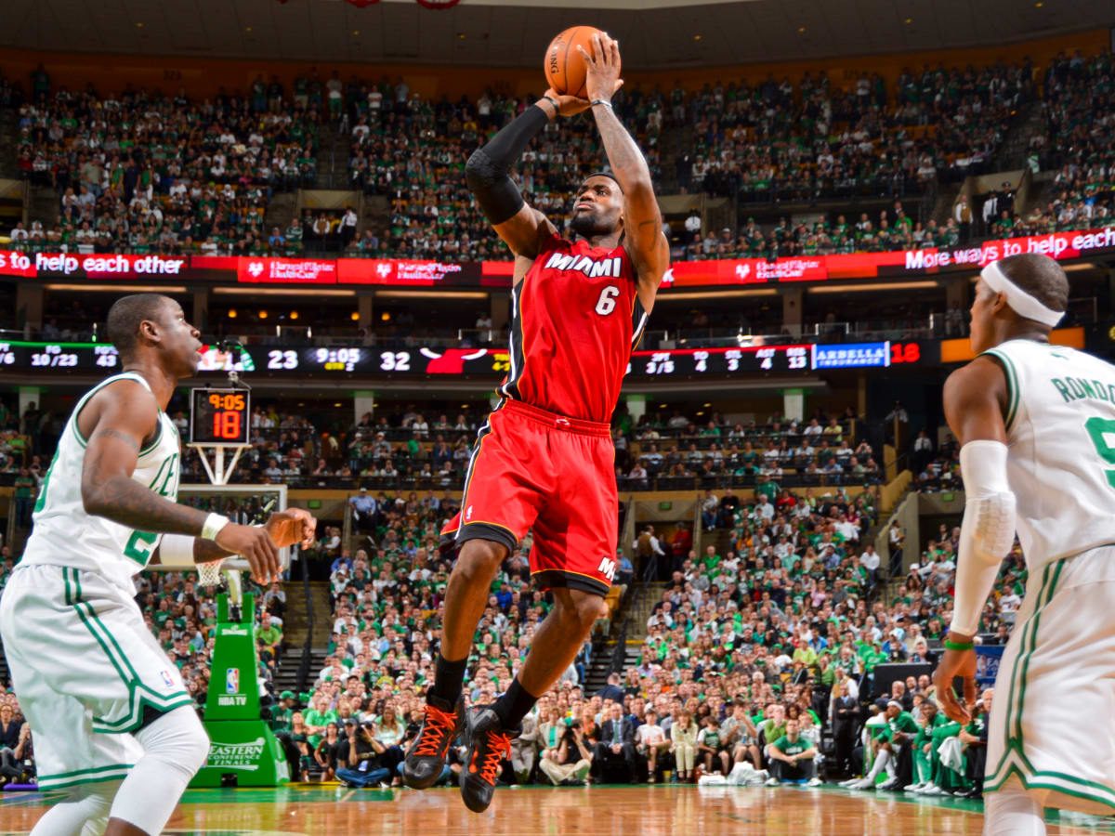
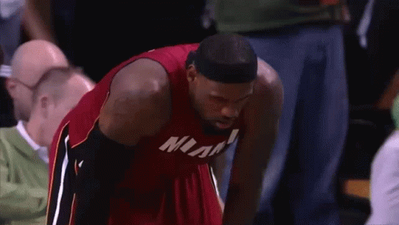
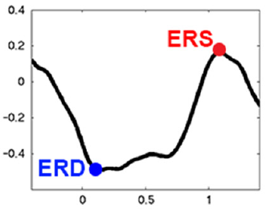
Background
β-Frequency profile
β-Frequency profile

Slide 3


Background
β-Modulation
=
β-ERS - β-ERD
β-Modulation
Movement

Slide 4
Background
β-Modulation
=
β-ERS - β-ERD
HIGHER
β-Modulation
HEALTHIER

Slide 5
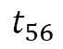
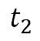
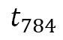
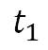
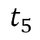
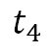
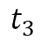
Data Collection The experiment
1
8
2
2
7
7
3
3
6
4
5
An increasing offset is imposed on the pad every two sets!
+10°,…,+60°
+10°
t
$$t_{1}$$
$$t_{2}$$
$$t_{3}$$
$$t_{4}$$
$$t_{5}$$
$$t_{56}$$
. . . . .
$$t_{784}$$
Set 1
Set 14

Slide 6

Data Collection The experiment
t
$$t_{1}$$
$$t_{2}$$
$$t_{3}$$
$$t_{4}$$
$$t_{5}$$
$$t_{56}$$
. . . . .
$$t_{784}$$
Set 1
Set 14

Slide 7
Dataset
23 subjects
5 variables
Abs Normalized Area
Abs Directional Error
Peak Velocity
Reaction Time
+
β-Modulation
2
FUNCTIONAL DATA!
For each subject:
56 obs x 14 sets = 784 obs
REMARK: Observations are time-correlated.

Slide 8
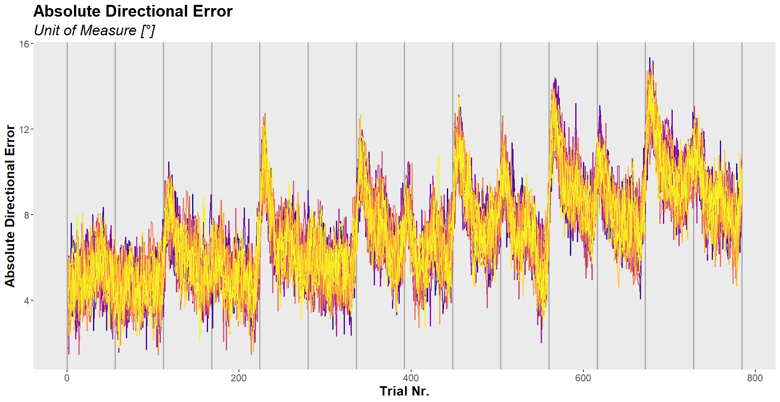
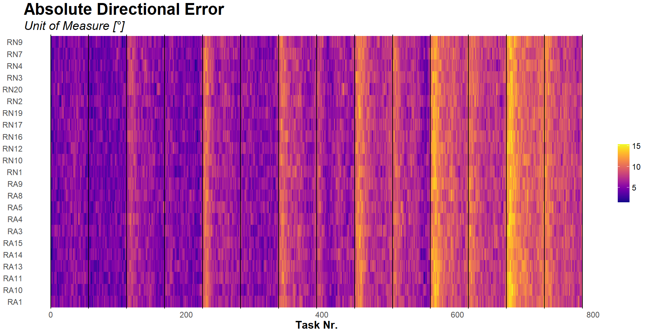
Dataset
RESET
READJUSTMENT

Slide 9
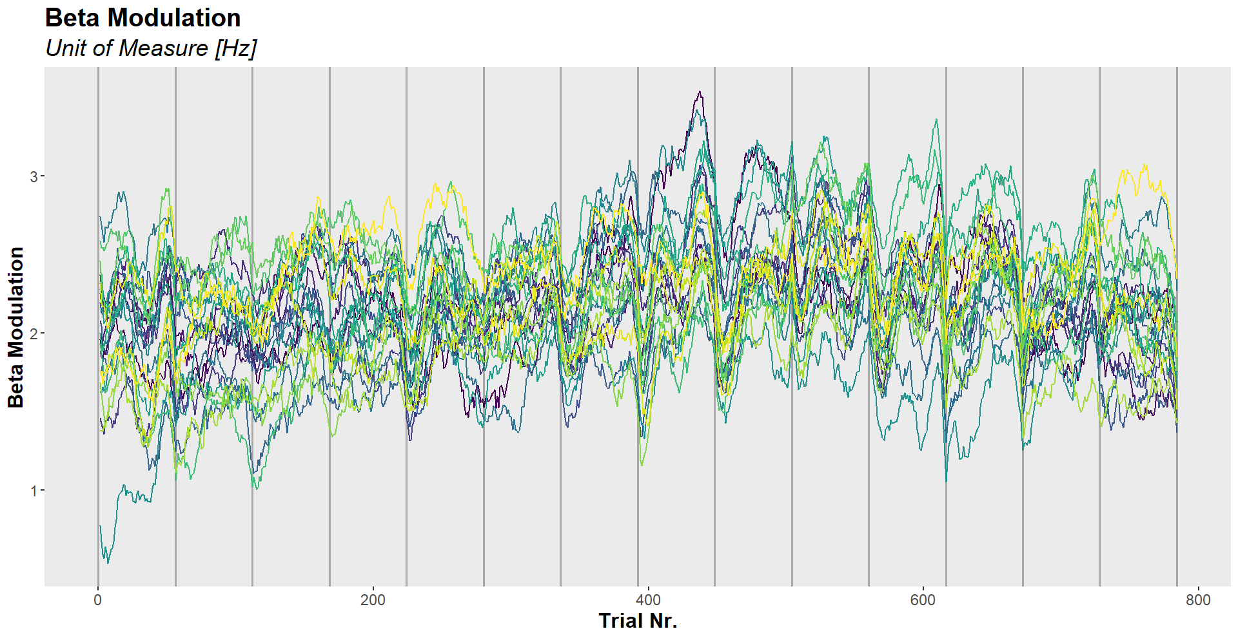
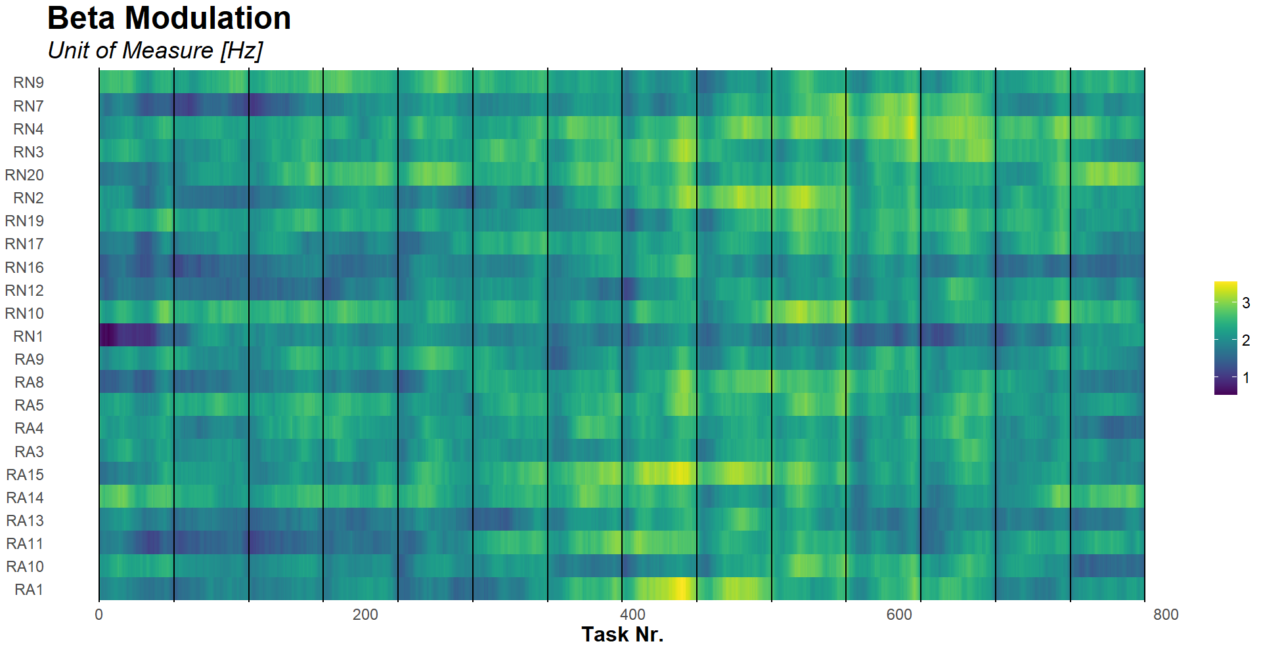
Dataset
PRACTICE
FATIGUE

Slide 10
Research Questions
Difference in β-Modulation in subjects:
AWAKE vs NAP
“Practice Effect” in the β-Modulation behavior?
Dependency between the β-Modulation and the other variables?

Slide 11
Research Questions
Difference in β-Modulation in subjects:
AWAKE vs NAP
“Practice Effect” in the β-Modulation behavior?
Dependency between the β-Modulation and the other variables?

Slide 12
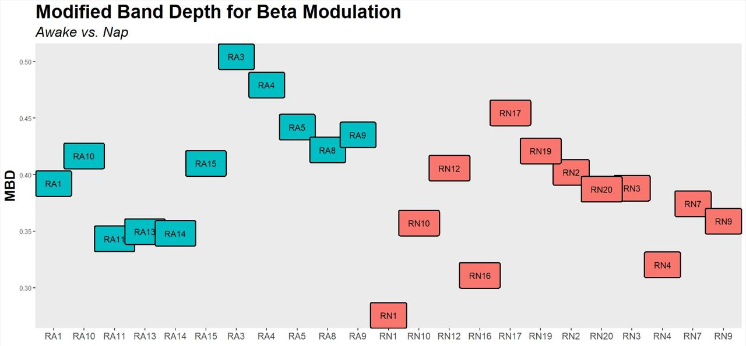
Test: Awake vs Nap
AWAKE
NAP

Slide 13
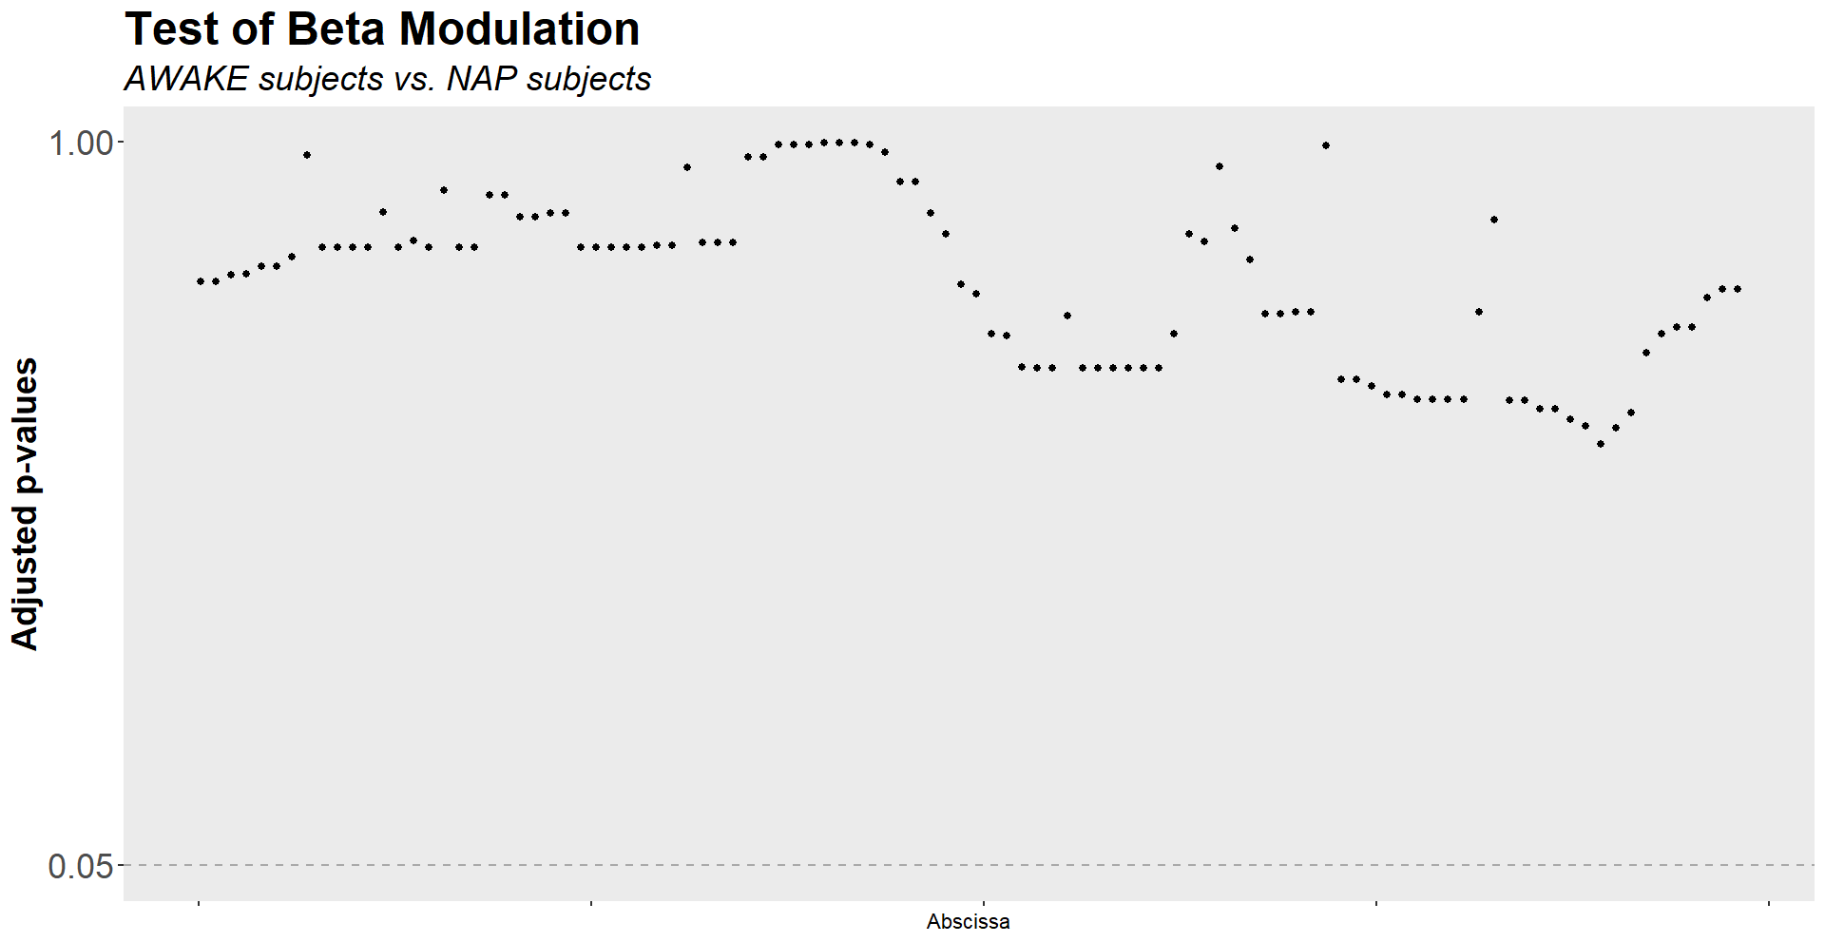
Test: Awake vs Nap
$$H0:βMod_{awake}=βMod_{nap} vs. H1:βMod_{awake}≠βMod_{nap}$$
Two Populations Interval-Wise Test for Functional Data

Slide 14
Research Questions
Difference in β-Modulation in subjects:
AWAKE vs NAP
“Practice Effect” in the β-Modulation behavior?
Dependency between the β-Modulation and the other variables?

Slide 15
Test: Set-Wise Practice Effect
Goal: To compare local behavior of β-Modulation between sets
$$H0:βMod_{set_{i}}=βMod_{set_{j}} vs. H1:{\left(H0\right)}^{c} , i≠j$$
N.B. Particular importance to the comparisons between initial and final sets.

Slide 16
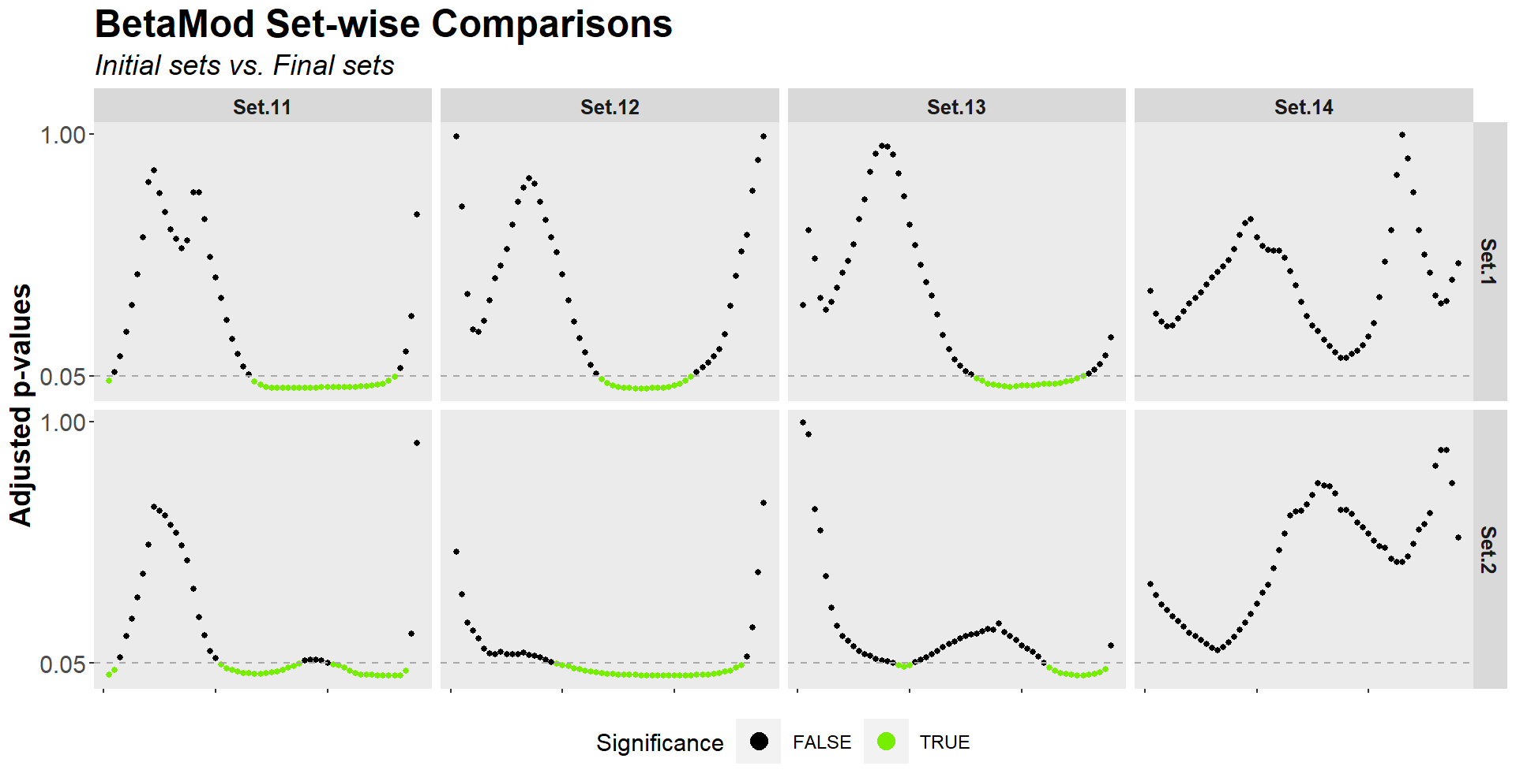
Test: Set-Wise Practice Effect
Two Pop. paired Interval-Wise Test for Functional Data
FATIGUE
RESET
READJUST
PRACTICE

Slide 17
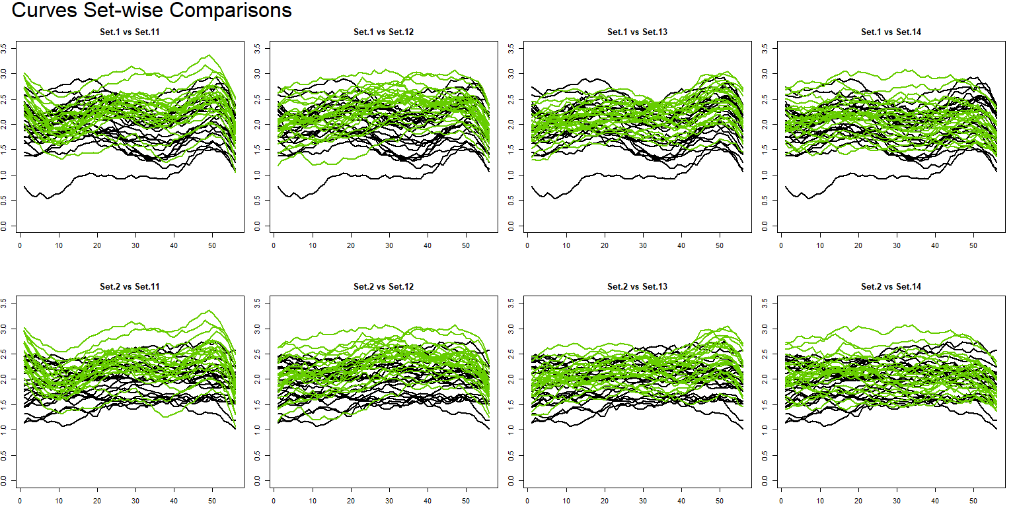
Test: Set-Wise Practice Effect
Two Pop. paired Interval-Wise Test for Functional Data

Slide 18
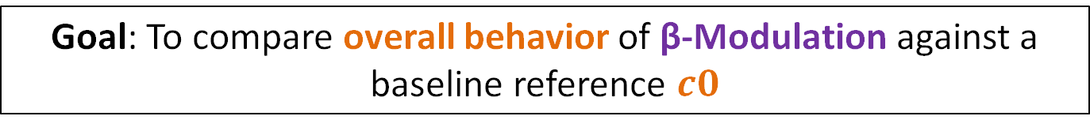

Test: Overall Practice Effect
Goal: To compare overall behavior of β-Modulation against a baseline reference $c0$
$$c0=\frac{1}{2∙23∙784}\sum_{i=1}^{2}{\sum_{j=1}^{23}{\sum_{t=1}^{784}{βMod_{i,j}\left(t\right)}}}$$
$$H0: βMod=c0 vs. H1: βMod≠c0$$

Slide 19
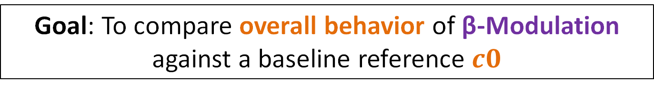
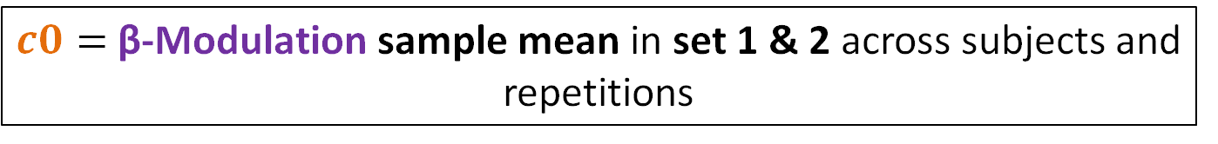
Test: Overall Practice Effect
Goal: To compare overall behavior of β-Modulation against a baseline reference $c0$
$c0=$ β-Modulation sample mean in set 1 & 2 across subjects and repetitions
$$H0: βMod=c0 vs. H1: βMod≠c0$$

Slide 20
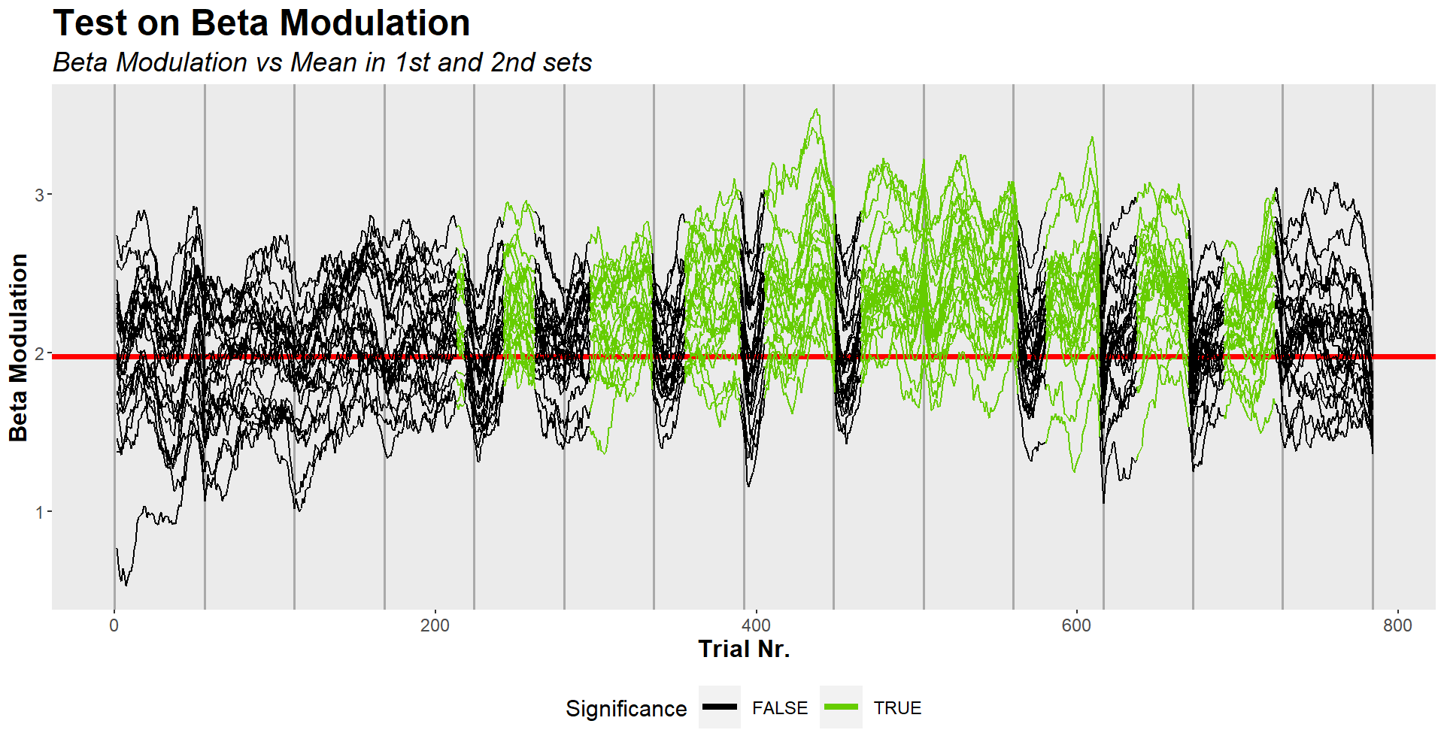
Test: Overall Practice Effect
One Population Interval-Wise Test for Functional Data

Slide 21
Research Questions
Difference in β-Modulation in subjects:
AWAKE vs NAP
“Practice Effect” in the β-Modulation behavior?
Dependency between the β-Modulation and the other variables?

Slide 22
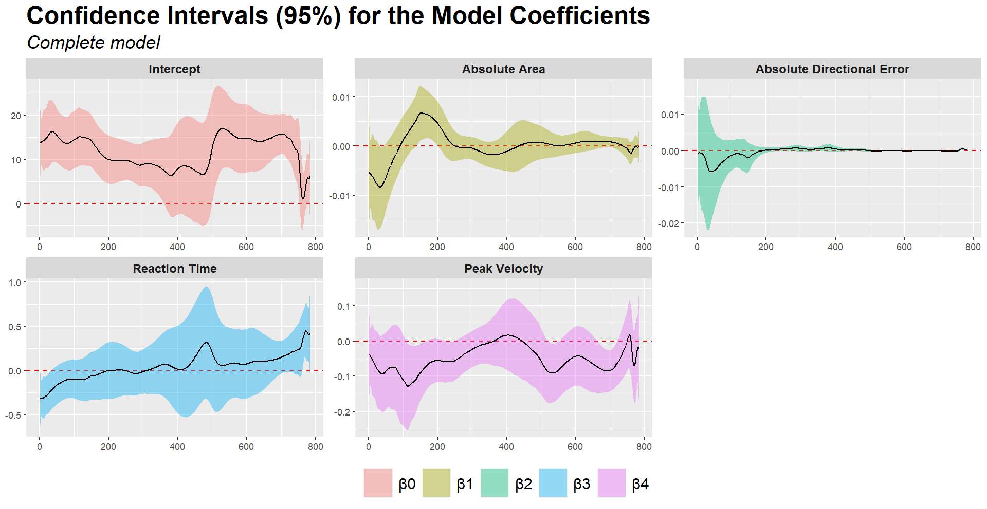

Regression Model The concurrent model
SMOOTHING
Interested in general trend
High penalization factor
$$y_{i}\left(t\right)=β_{0}\left(t\right)+\sum_{j=1}^{q−1}{x_{ij}\left(t\right)β_{j}\left(t\right)}+ε_{i}\left(t\right)$$
Complete Model

Slide 23
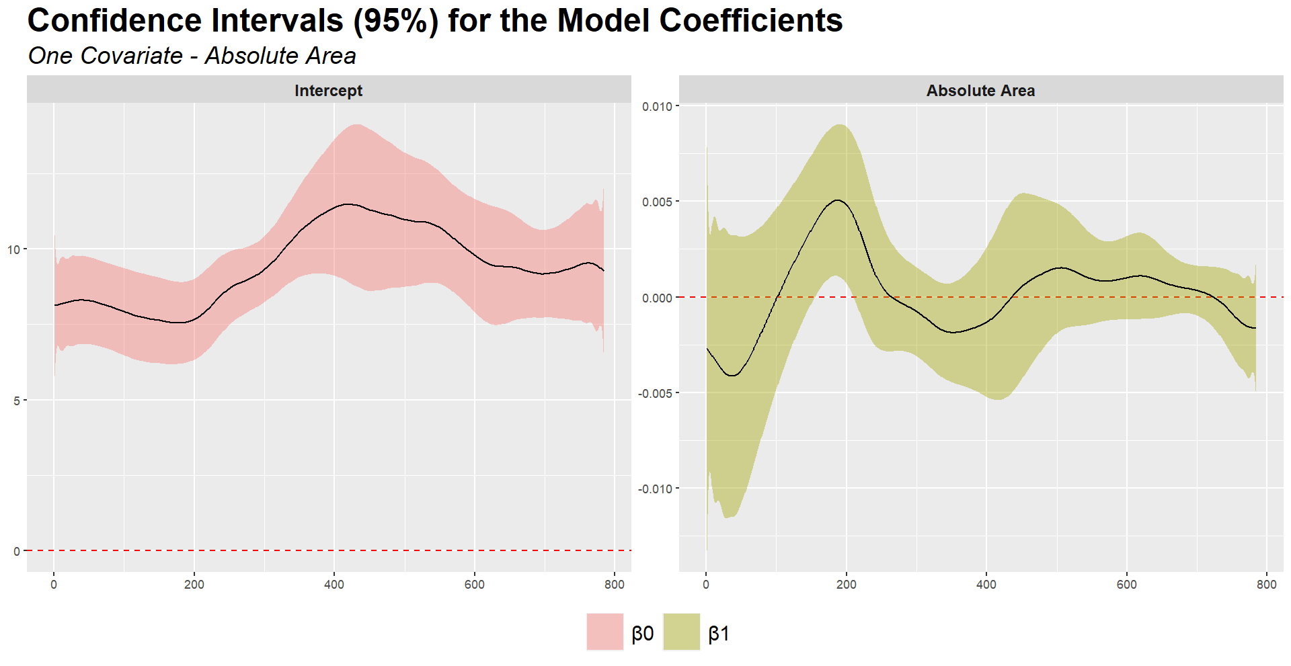
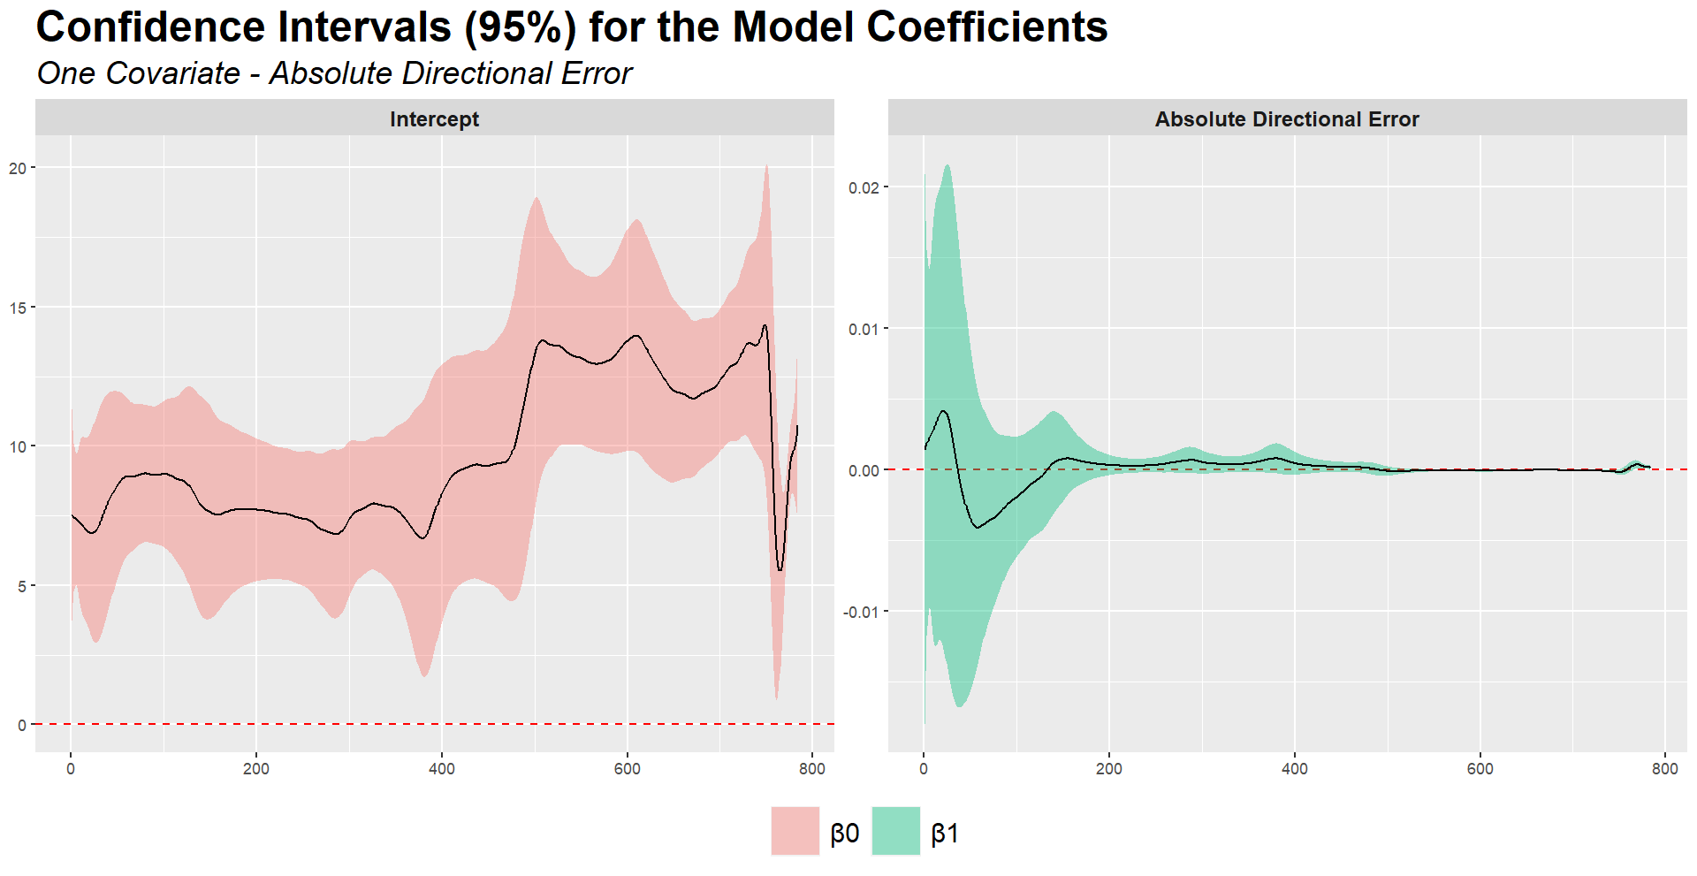
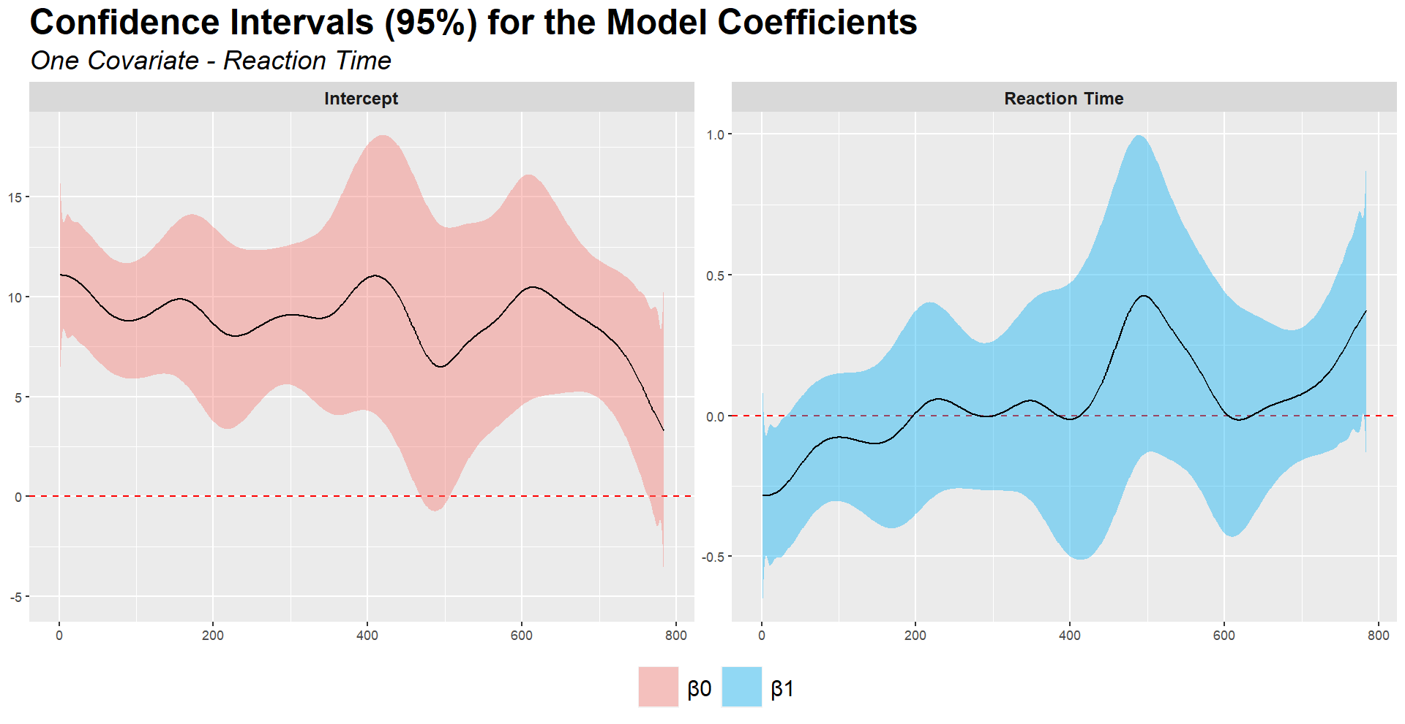
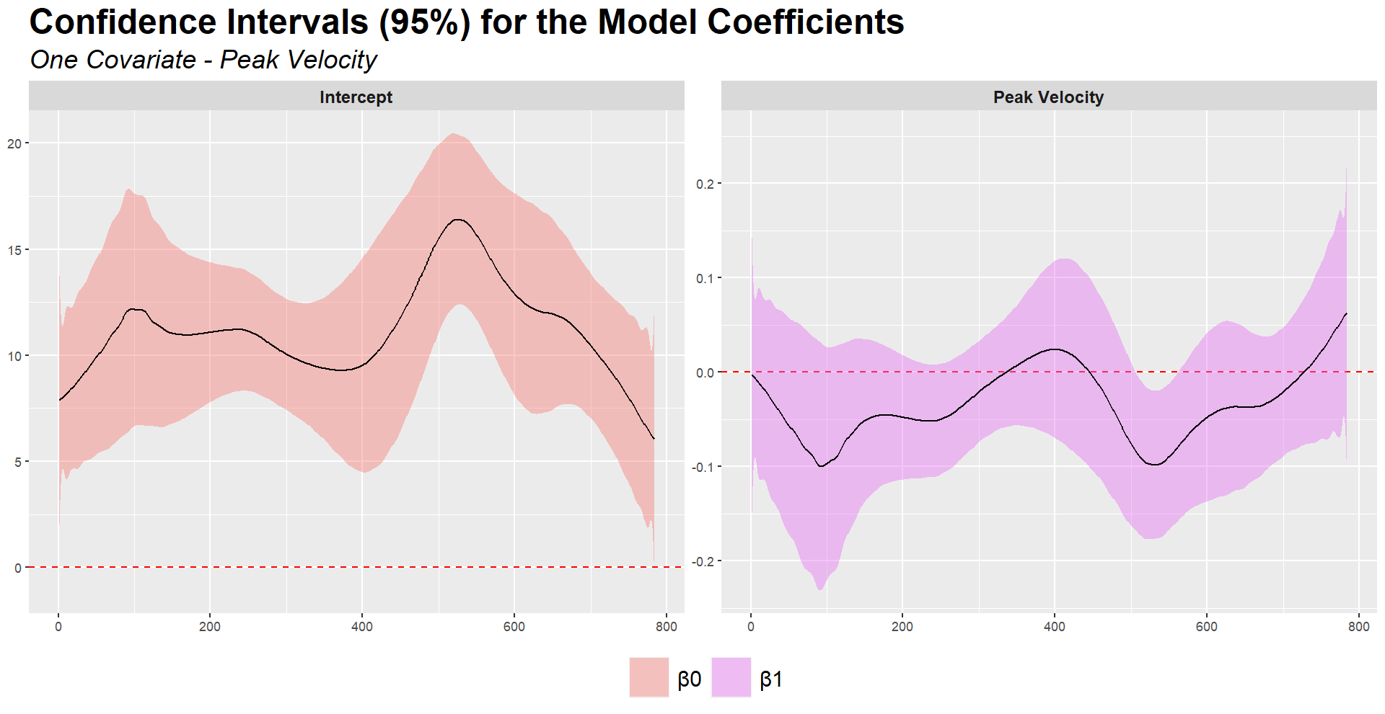
Regression Model The concurrent model
Reduced Models

Slide 24
Conclusions
The condition of rest does not seem to affect the β-Modulation of the subjects
The practice shows an effect on the β-Modulation , which increases with time until the fatigue becomes relevant
The impact of the cinematic quantities collected in describing the β-Modulation is negligible to absent

Slide 25
Future Developments
Analysis of some neurological illnessess effects comparing healthy and affected subjects
Analysis of complete movement trajectories
Fit a regression model using historical models approach

Slide 26
THANK YOU FOR THE ATTENTION!!!

